Slide 1
Capstone Project : 1
Hotel Booking Analysis Team Members: Priya Bodke : priya.bodke41@gmail.com Awaze Mohammad : awazemohd@gmail.com

Slide 2
Work Flow
1. Problem Statement
2. Data Collection and Understanding
3. Data cleaning and Manipulation
4. Exponential Data Analysis(EDA)
5. Conclusions

Slide 3
Finding Statements
1. Which type of hotel mostly preferred by guest ?
2. Which months has the most bookings?
3. Which year has the highest bookings?
4. From which country most guest are coming?
5. What are the percentage of repeated guests?
6.How many guests required car parking?
7.Hotel type and cancellation rate
8.Which distribution channel is mostly used for hotel booking?
9. Which is most preferred room type by the customer ?
10. Market segment on the basis of months ?

Slide 4
Finding Statements
11.Which hotel has the highest ADR?
12. Which market segment has the highest cancellation rate ?
13. Which type of meal(food) is most preferrable?
14.Which hotel type has longer waiting time?
15.What is the ADR across different months?
16.Which distribution channel is more effective for increasing the income of hotel?
13.

Slide 5
Data Summary
The dataset spans over three years - 2015, 2016 and 2017.
1.hotel: Denotes the type of hotel - Resort hotel or city hotel
2.is_canceled: Indicates if the booking was canceled(1) or otherwise(0)
3.lead_time: Number of days between the entering date of the booking and the arrival date
4.arrival_date_year: Year of arrival date
5.arrival_date_month: Month of arrival date
7.arrival_date_week_number: Week number of the year for arrival
Date
8.arrival_date_day_of_month: Day of arrival date
9.stays_in_weekend_nights: Number of weekend nights
10.stays_in_week_nights: Number of week nights

Slide 6
Data Summary
11.adults: Number of adults
12.children: Number of children
13.babies: Number of babies
14.meal: Type of meal booked
15.country: Country of origin
16.market_segment: Different market segments
17.distribution_channel : Booking distribution channels
18.is_repeated_guest: Is repeated guest(1) or not(0)
19.previous_cancellations: Number of previous bookings cancelled by the
customer before current booking
20.previous_booking_not_canceled: Number of previous bookings not
cancelled by the customer before current booking
21.reserved_room_type: Code of room type reserved

Slide 7
Data Summary
22.assigned_room_type: Code of the assigned room type reserved
23.deposite_type: No Deposite, Non Refund,Refundable
24.agent: Id of travel agency that made booking
25.company: Id of the company that made booking
26.days_in_waiting_list: The number of days the booking was in waiting
27.customer_type: Types of customer
28.adr: Average Daily Rate
29.required_car_parking_spaces: Nof car parking spaces required by the customer
30.total_of_special_requests: Number of special request made by customer
31.reservation_status: Reservation of last status

Slide 8
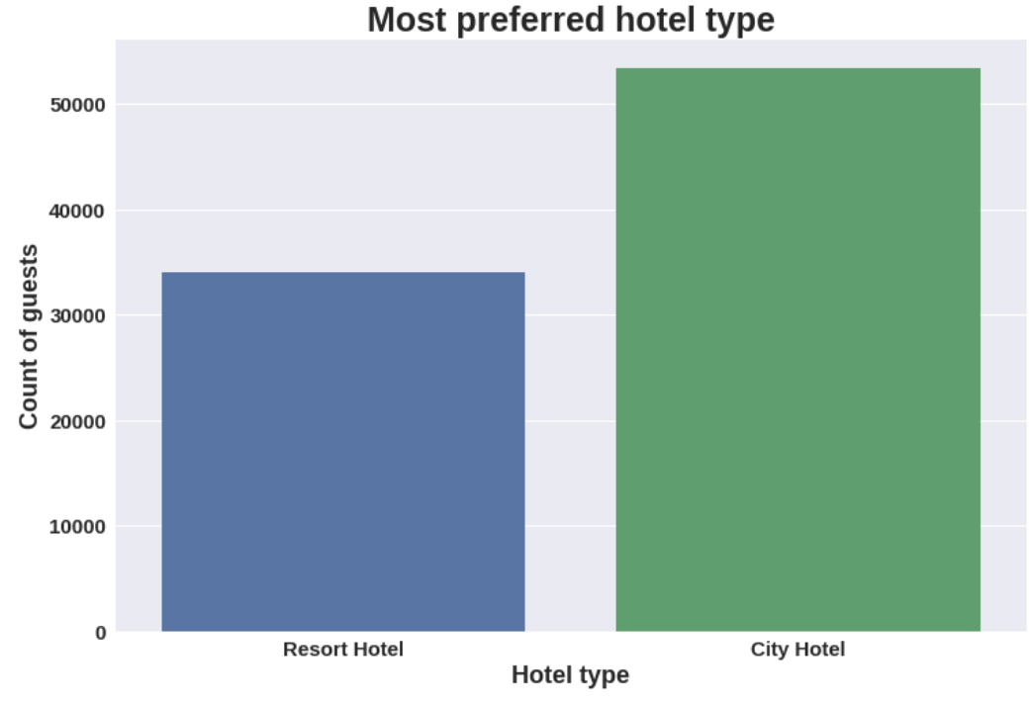
1. Which type of hotel mostly preferred by guest ?
0
City hotel is the most preferred hotel type by the guests.

Slide 9
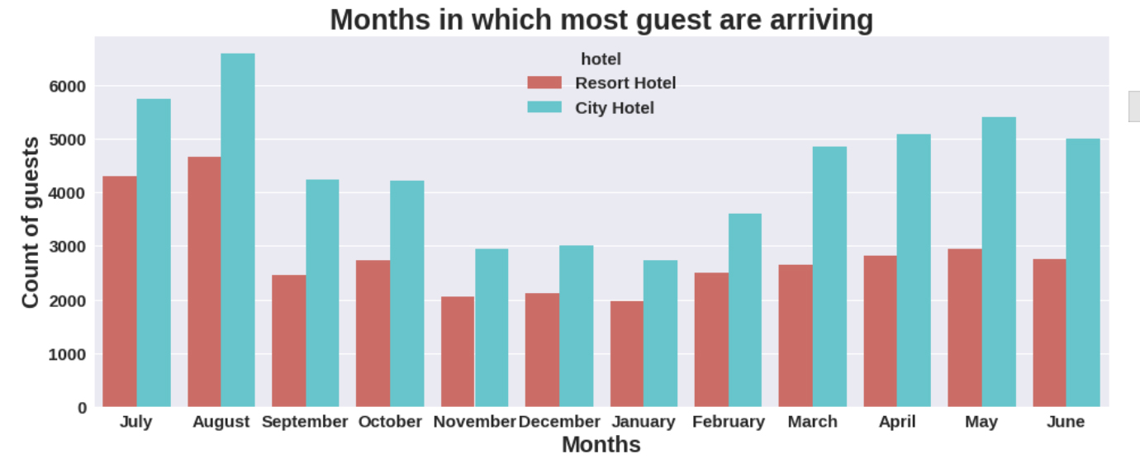
2. Which month has the most bookings ?
0
August month has the most guests bookings in both type of hotel Bookings are also high in May and July

Slide 10
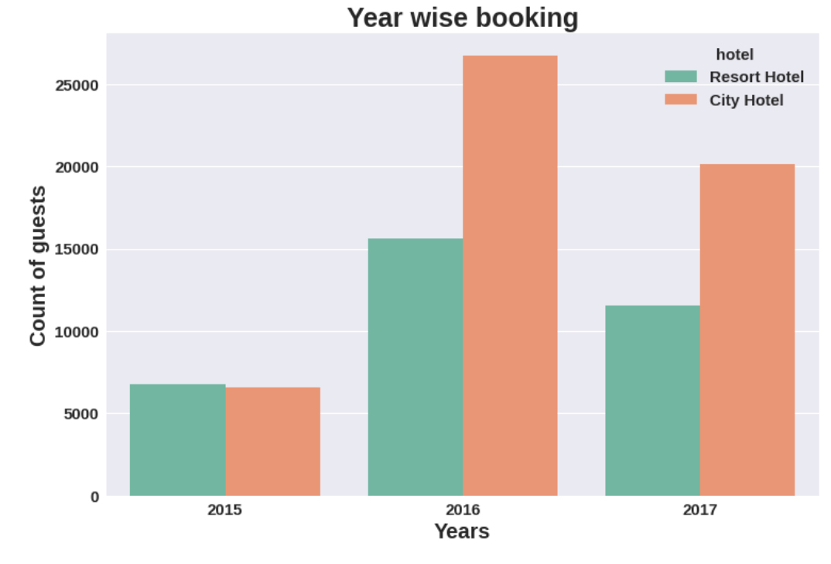
3. Which year has the highest bookings?
0
Graph shows the bookings for both city hotel and resort hotel is high in the year 2016 and very less in 2015

Slide 11
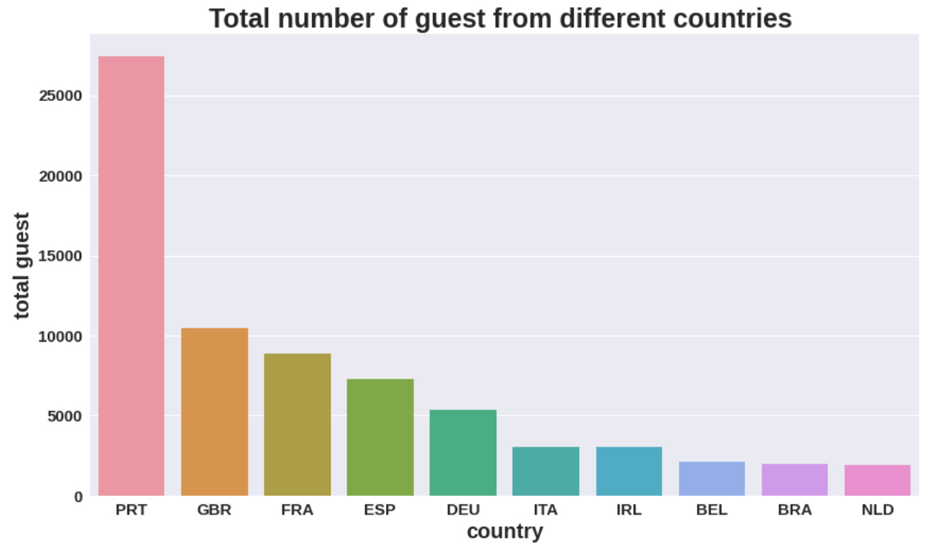
4. From which country most guest are coming?
0
It shows top 10 countries from where most of the guest are arriving as per the graph most number of guests coming from PRT(Portugal) followed by GBR(Great Britain) and FRA(France)

Slide 12
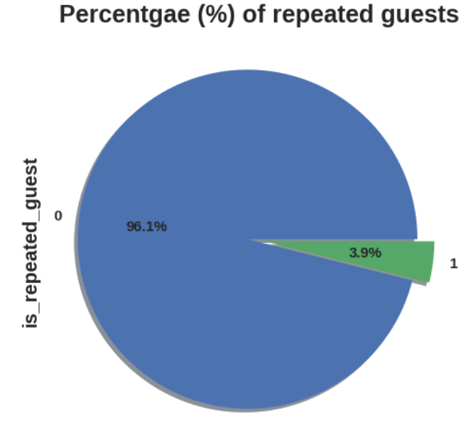
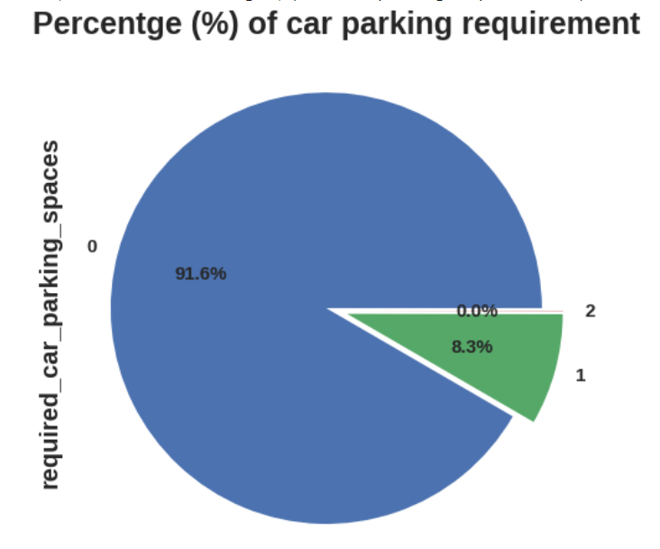
5. What are the percentage of repeated guests?
6. How many guests required parking space?
0
Only 3.9% guests are repeated
Remaining 96.1% were new guests.
Most of the customers do not required parking spaces only 8.3% requires 1 parking space.

Slide 13
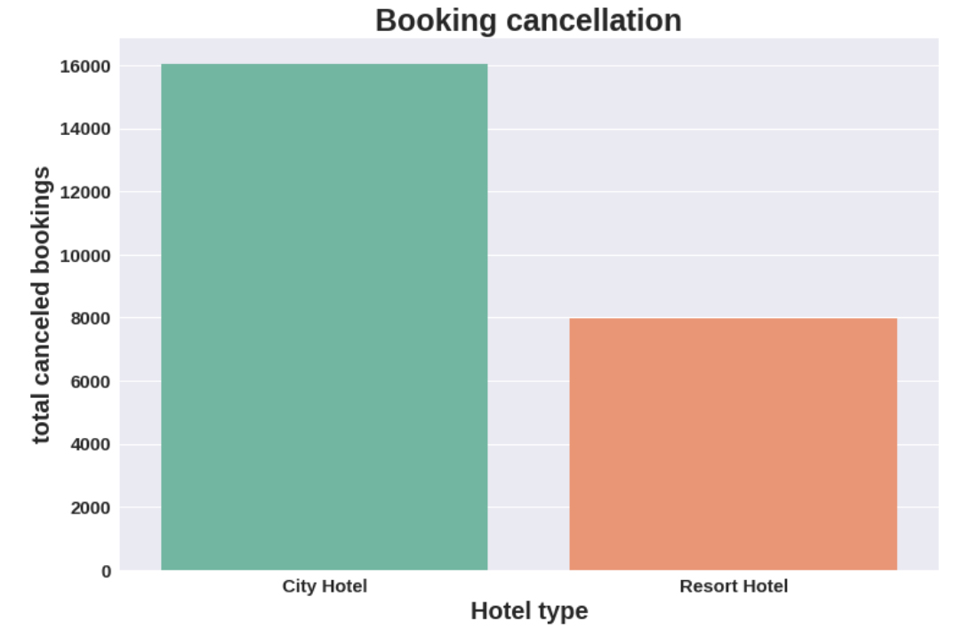
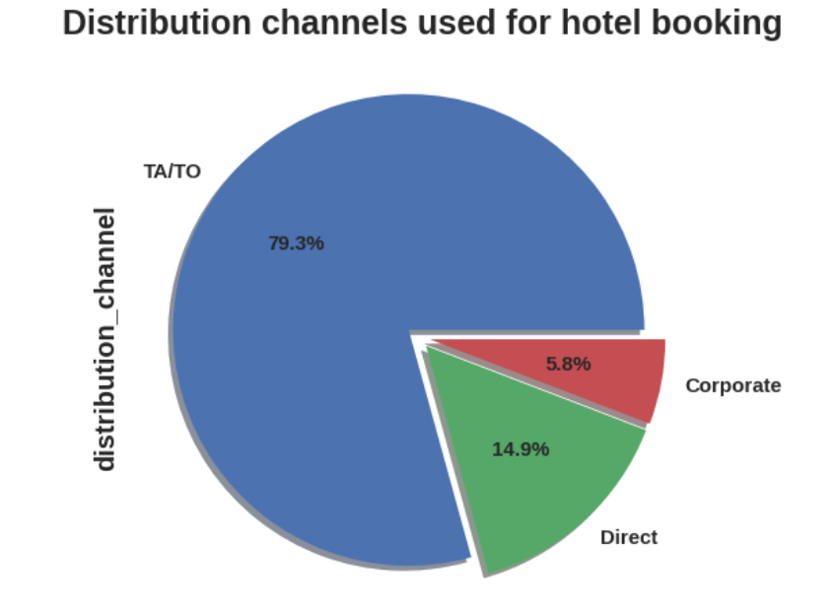
7. Hotel type and cancellation rate
8.Which distribution channel is mostly used for hotel booking
City hotel has the high booking cancellation rate than the Resort hotel.
79.3% Bookings were made through TA/TO,
Second most channel is Direct.

Slide 14
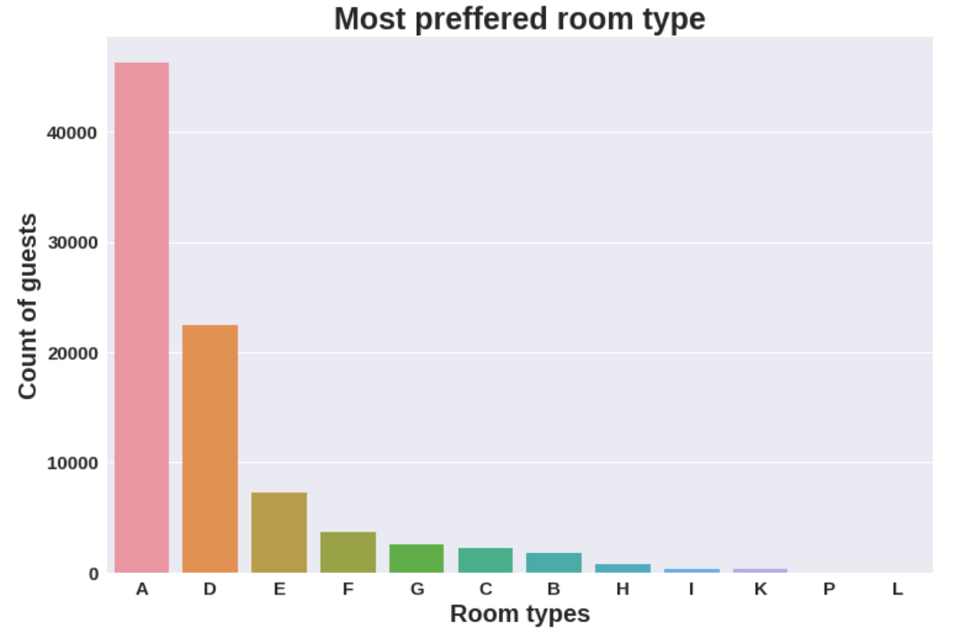
9.Which is the most preferred room type by the customers?
0
Most guests preferred room type is A, Second most Preferred is D

Slide 15
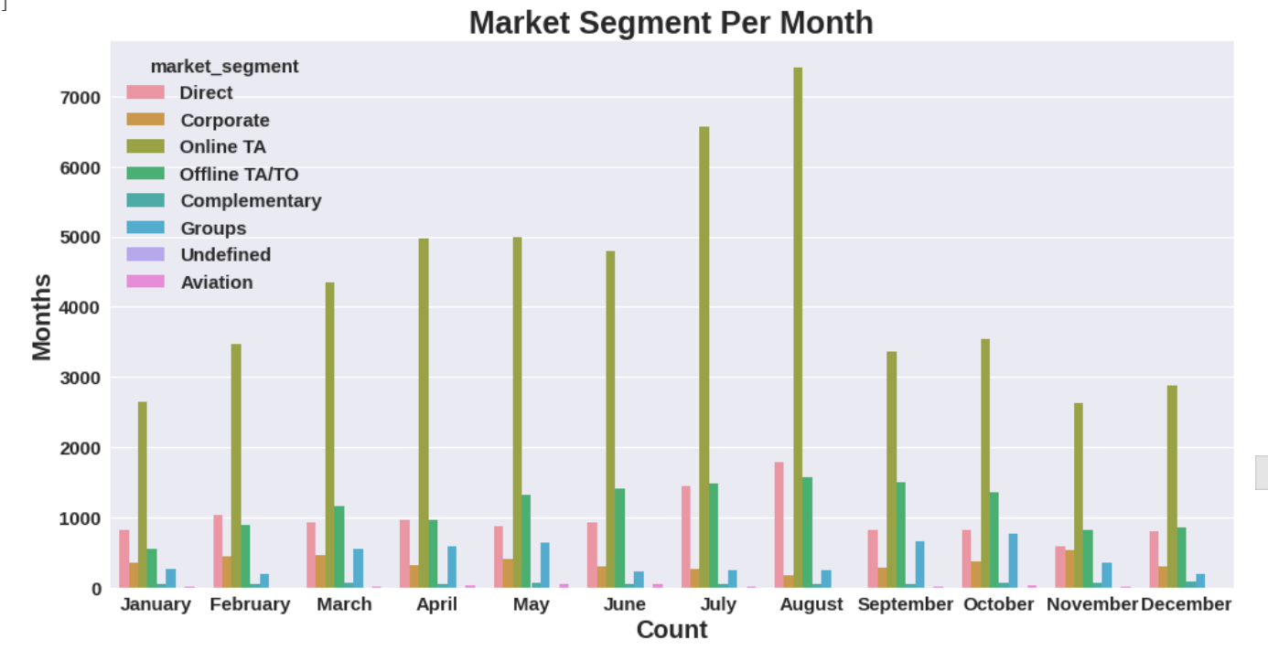
10.Market segments on the basis of months?
0
Most of the hotels are booked by online TA(travel agent) in the August month

Slide 16
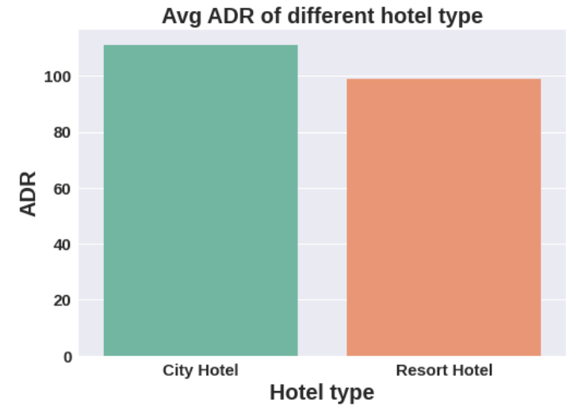
11.Which hotel has the highest ADR?
0
Avg ADR for city hotel is high as compared to resort hotel, These city hotels are generating more revenue than Resort hotel

Slide 17
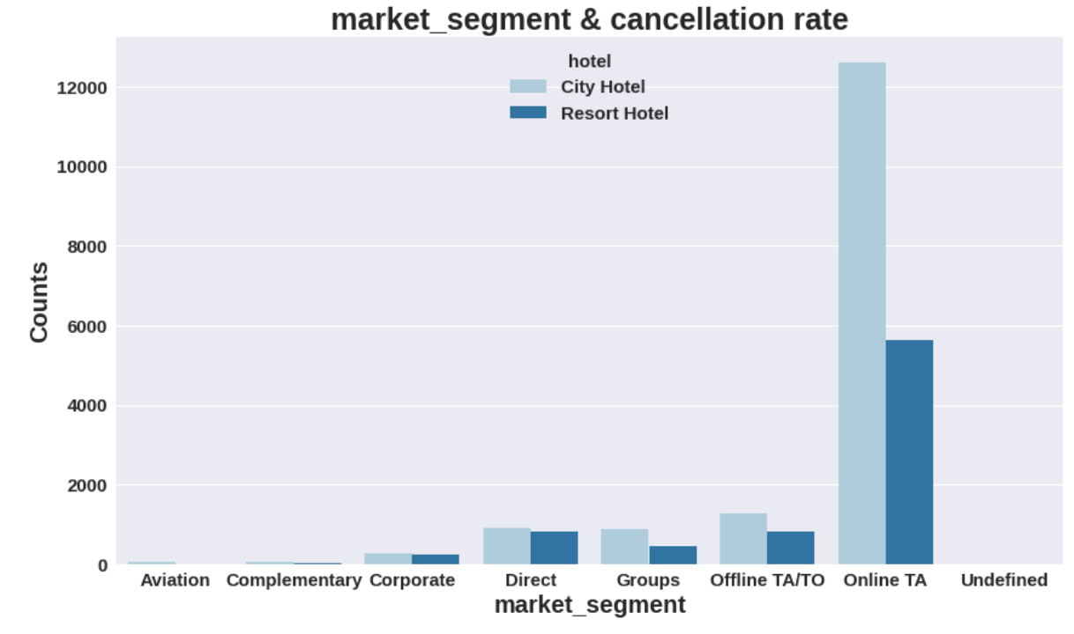
12.Market segment has the highest cancellation rate?
0
Online TA(travel agent) has the highest cancellation rate in both type of hotels.

Slide 18
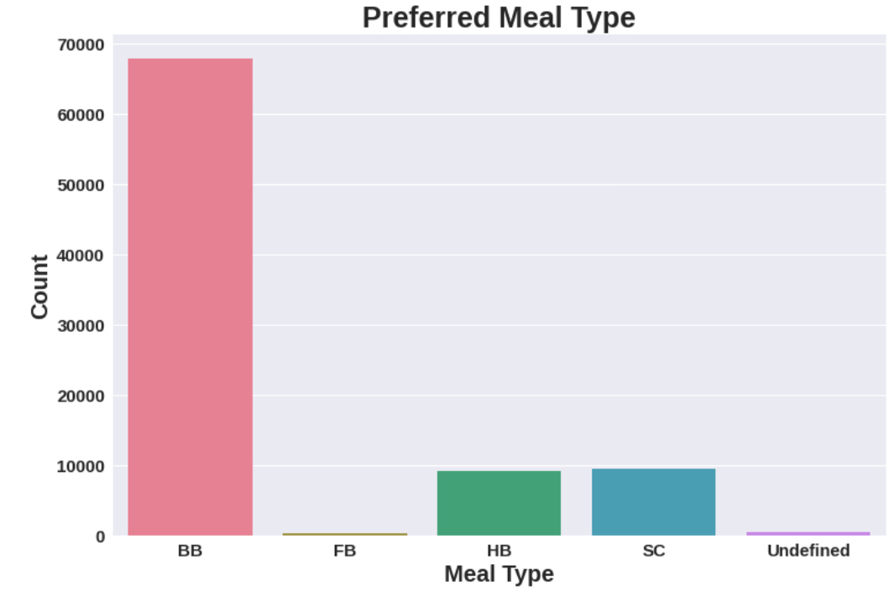
13.Which type of meal(Food) is more preferred?
0
BB(Bread and breakfast) is most preferred meal type by the guest.
FB(full bed) is least preferred

Slide 19
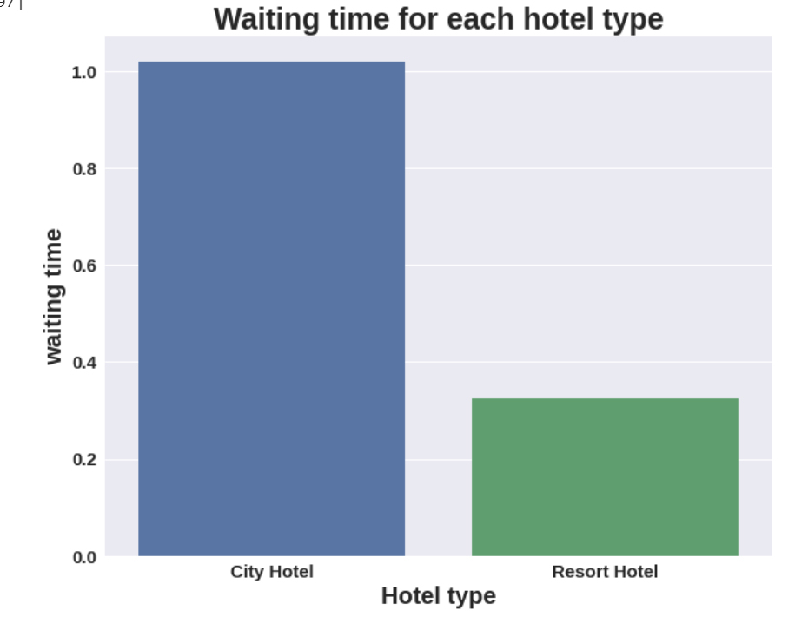
14.Which hotel has the longer waiting time?
0
City hotel has longer waiting time as compared to Resort hotel,
So city hotels are much busier than the resort hotel

Slide 20
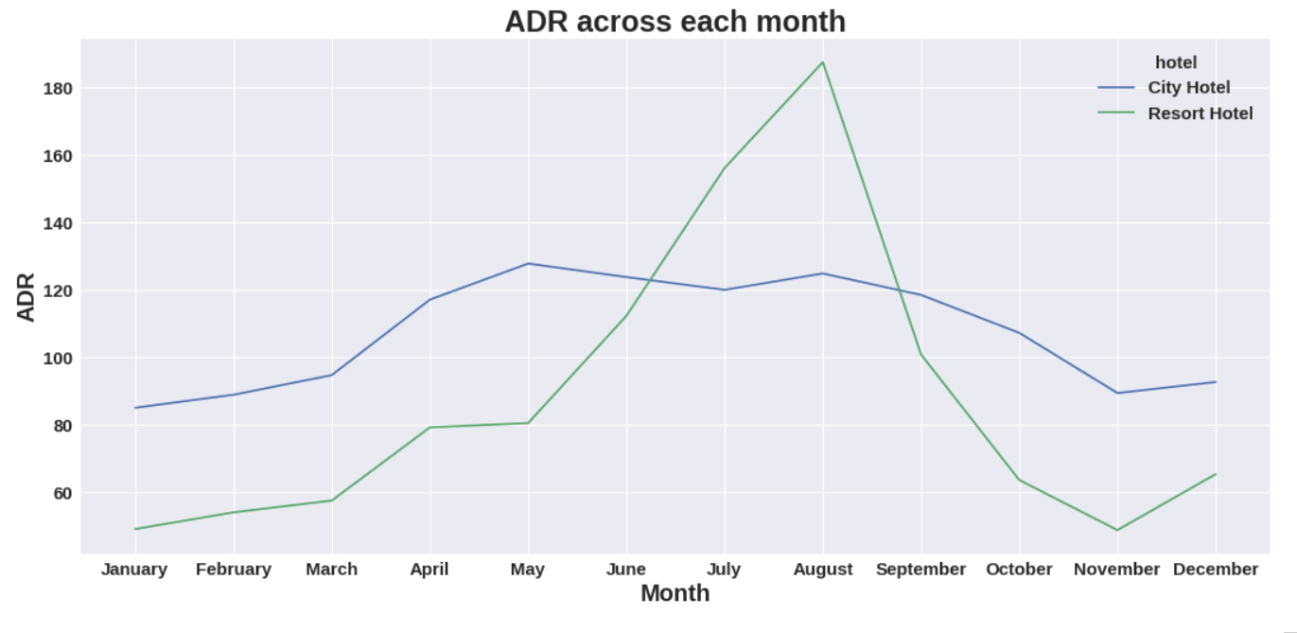
15.What is ADR across different months?
0
Resort hotels had the highest ADR in July and August than the City hotels. But in other months ADR of Resort hotel was less than the City hotels.

Slide 21
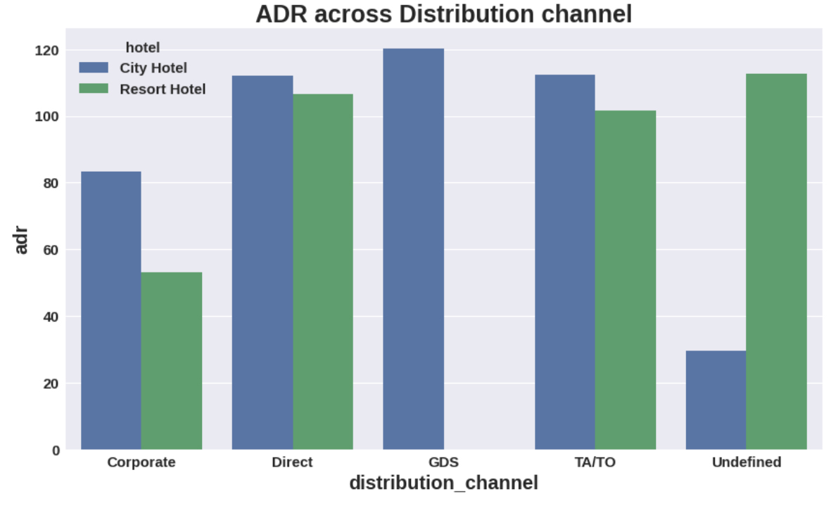
16.Which distribution channel is more effective for increasing the income of hotel?
0
Graph shows GDS is more effective in city hotels but it needs to improve in Resort hotel as well.TA/TO and Direct is almost equally contributed in both type of hotel for increasing their income.
.

Slide 22
Conclusions:
1. Resort hotel needs to work more on their marketing strategy and they should promote their hotel more on social media platforms in order to increase the number of guests.
2. Resort hotels could also reduce prices to increases booking percentages.
3. Avg ADR for city hotel is high as compared to resort hotel, These city hotels are generating more revenue than Resort hotel
4.Given that hotels do not have more repeated guests, hotels may implement extra benefits offer for repeated guest, to attract them.
5. August month has the most guests bookings in both type of hotel Bookings are also high in May and July (ie.more than 8000)
6. Although city hotels have more bookings, they also tend to have more cancellations so to prevent this they could take advance money during vacation. They could also apply minimum charge policies This would ensure most bookings to not being cancelled.

Slide 23
Conclusions:
7.We also realize that the high rate of cancellations can be due high no deposit policies.
8. City hotel has longer waiting time as compared to Resort hotel,
So city hotels are much busier than the resort hotel.
9. BB(Bread and breakfast) is most preferred meal type by the guest, FB(full bed) is least preferred.
10. 82.1% Bookings were made through TA/TO,Second most channel is Direct.
11. It shows top 10 countries from where most of the guest are arriving as per the graph most number of guests coming from PRT(Portugal) followed by GBR(Great Britain) and FRA(France)
12.Year 2016 is the peak year for hotel booking and 2015 has very less bookings.
13. The hotel reservation tends to peak during July and August.
9

Slide 24
Conclusions:
14. Graph shows different market segments across months, According to this graph in every month online TA segment effects the most.
15.City Hotels has longer waiting period than the Resort Hotel.
16. Online T/A(Travel agent) has the highest cancellation in both type of hotel.
17. The most preferred Room type is "A".
18.As the graph shows very few guests required car parking.
19. Graph shows GDS is more effective in city hotels but it needs to improve in Resort hotel as well. TA/TO and Direct is almost equally contributed in both type of hotel for increasing their income.

Slide 25
Q & A

